Slide 1
Dementias Platform UK: Trials delivery and the role of Scotland
Vanessa Raymont
Associate Professor, University of Oxford
R&D Director & Consultant Psychiatrist, Oxford Health NHS Foundation Trust
Associate Director, DPUK
Joint Deputy Chair, NIHR Dementia Translational Research Collaboration

Slide 2
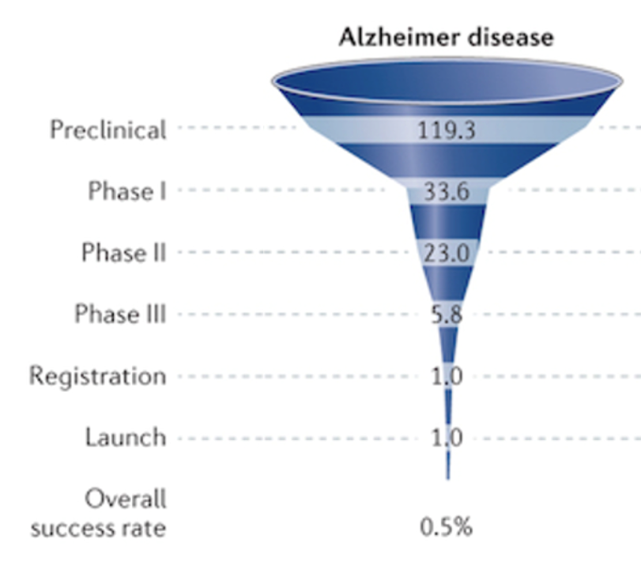
Clinical trials in Alzheimer’s disease
Drug pipeline
>90% clinical trials failed before
Inclusion criteria
Trial design
Outcome measures
Now…biggest changes in >20 years
Clinical trial landscape

Slide 3
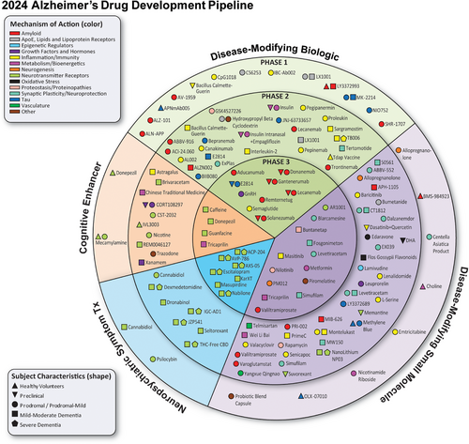
Ongoing AD clinical trials
Over past 5 years:
80% increased diversity
More repurposed drugs
More in mild stages
More use of biomarkers
Combinations may be best
Cummings et al., Alzheimer’s Dement. 2024

Slide 4
So where are we?
Disease modifying drugs (e.g. lecanemab, donanemab) seem clinically meaningful
Likely initial use = < 30k/year
Who will access and where?
Starting to have clinical impact and service implications

Slide 6
2021/22 - 44% drop in recruitment to clinical trials over 5 years
Number of clinical trials per year fell by 41%
61 recruited to late phase dementia trials in England
2021 - Life Sciences Vision & The Future of UK Clinical Research Delivery
2022 - ARUK - ‘We are at a tipping point for progress in dementia research’
2023 - O'Shaughnessy review - research not well prioritised in NHS and
value of participating not effectively communicated

Slide 7
Trials need to be
Faster
More efficient
Real world/embedded
UK and beyond

Slide 8
UK Dementia Infrastructure Changes
Dementia Mission & Dementia Trials Accelerator
NIHR D-TRC Trials Network
Dementias Platform UK 3

Slide 9
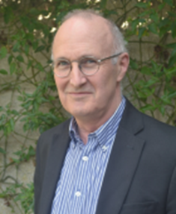
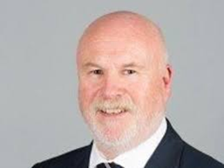
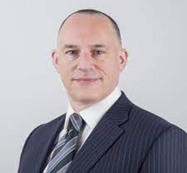
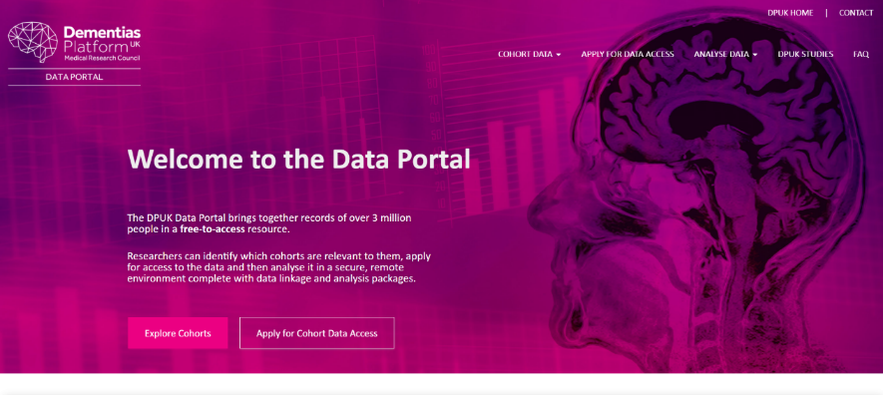
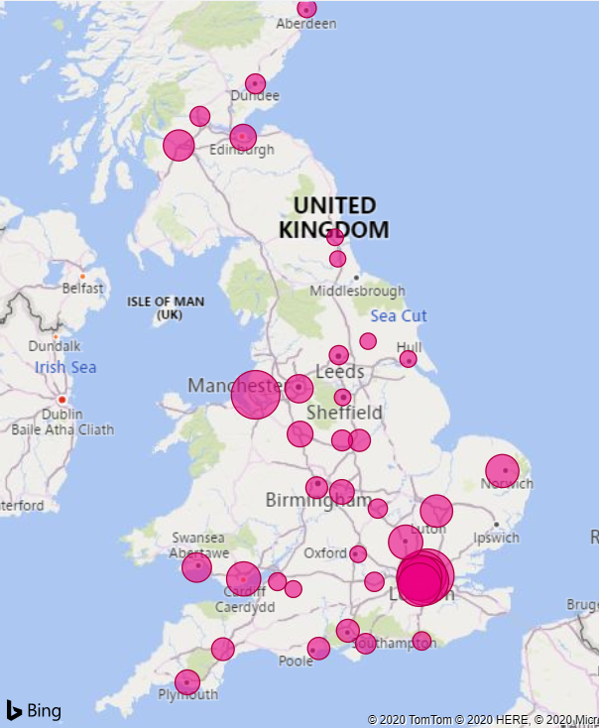
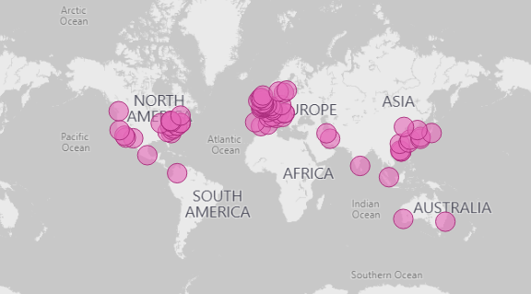
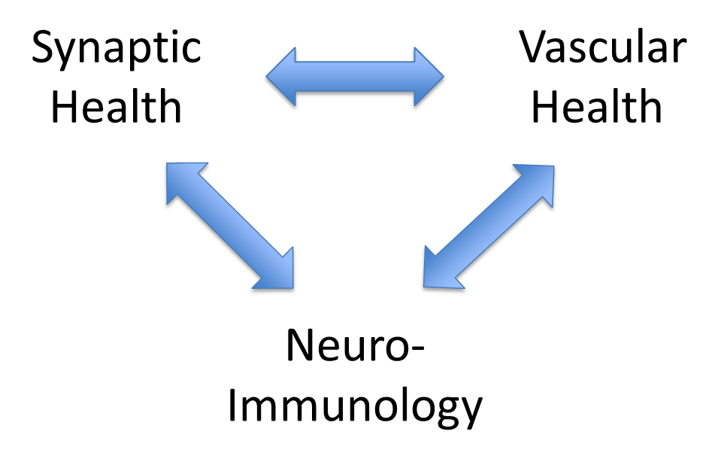
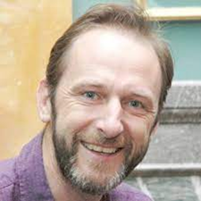
High trust pre-competitive environment
Close industry and academic alignment
Integrated data management across work streams
Pre-clinical testing
Early clinical testing
Efficacy
Surveillance
Mechanism discovery
Trials Delivery Framework
Precision recruitment
Great Minds & CSR
Efficient trials delivery
Stratification across
clinical sites
Data Portal
Cohorts: 63 (n=~4m)
Access requests: 1455
Registered users: 1023
Institutions: 102 (48 countries)
489 projects, 4 specialist hubs
DPUK
Experimental Medicine Incubator
Academic partners: 13
Industry/3rd sector partners: 15

Slide 10
Objective: Integrated, national trial delivery network
The Right Patient to the Right Place for the Right Project
Patients: Enriched characterization for trials readiness
Lead-in data: phenotype, genotype, cognition (preclinical cohorts & aiming for integration in clinical services)
Accurate feasibility & low screen failure
Precision rapid recruitment
Place: Pre-prepared centres for multi-site study delivery
Projects: Aligned with DPUK Experimental Incubator

Slide 11
The last 12 months
Growing well characterised healthy/preclinical registers
Largest dementia focused, diverse clinical network
Building on existing recruitment to trials and new CSF & blood biomarker infrastructure

Slide 12
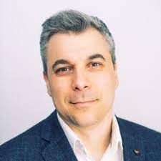
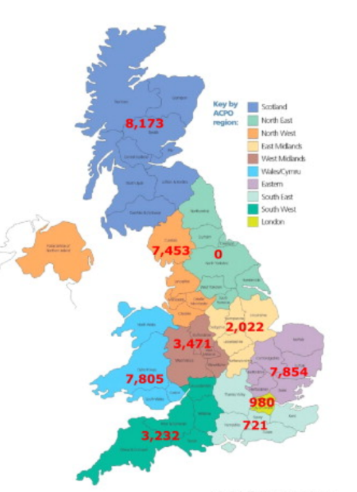
TDF Healthy/Preclinical Registers
Sources: Airwave, HealthWise Wales, Aberdeen cohort of 1950s, BDR, Early Onset AD Genetics cohort, SleepQuest, EPAD, JDR
Clinical Studies Register 58,333
Health questionnaire 55,682
Cognitive phenotyping 37,761
GWAS 22,267
Great Minds 10,292
Serial cognition 4,357
Genotyping 1,628
Actigraphy 283
26 studies ongoing/in set up

Slide 13
TDF Clinical Network
58 sites = biggest UK dementia focused trials network (1/4 Trusts, 1/4 GP practices), >8 studies offered last year
Relationships with Join Dementia Research, Brain Health Coalition
Plus Global Alzheimer’s Platform, Davos Alzheimer’s Collaborative, International Registry for Alzheimer’s Disease and other Dementias (InRAD)
= 1º/2º care real world characterisation/recruitment at scale, with NHS data linkage

Slide 14
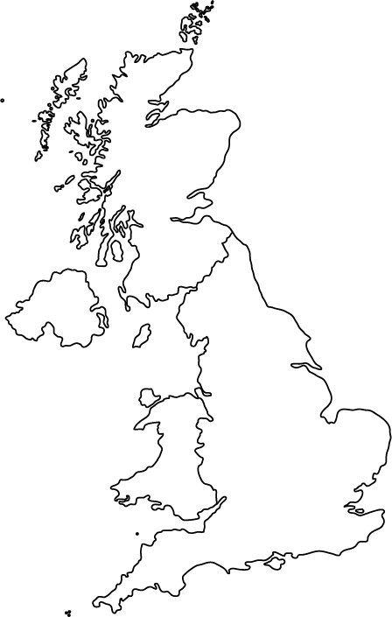
Aneurin Bevan University Health Board
Avon and Wiltshire Partnership NHS Trust – Kingshill Research Centre
Barking, Havering and Redbridge University Hospitals NHS Trust
Belfast Health & Social Care Trust BHC
Betsi Cadwaladr University Health Board
Berkshire Healthcare NHS Foundation Trust
Bodmin Brain Health Clinic
Bradford District Care NHS Foundation Trust
Brain Health Manchester/Greater Manchester Mental Health Trust
Bristol Brain Health Clinic/North Bristol NHS Trust
Cambridge University Hospitals NHS Foundation Trust
Cambridgeshire and Peterborough NHS Foundation Trust
Cardiff and Vale University Health Board
Central and North West London NHS Foundation Trust
Cornwall Partnership NHS Foundation Trust
Coventry and Warwickshire Partnership NHS Trust
Cwm Taf University Health Board
Devon Partnership NHS Trust
Dorset Healthcare University NHS Foundation Trust
East London NHS Foundation Trust
Essex Partnership University NHS Foundation Trust
Gateshead Health NHS Foundation Trust
Gloucestershire Health and Care NHS Foundation Trust
Herefordshire and Worcestershire Health and Care NHS Trust
Hull University Teaching Hospitals NHS Trust
Hull York Medical School
Humber Teaching NHS Foundation Trust
Hywel Dda University Health Board
Imperial College Healthcare NHS Trust
Lancashire and South Cumbria NHS Foundation Trust
Leeds and York Partnership NHS Foundation Trust
Lindsey Lodge Hospice
Lincolnshire Partnership NHS FT
Memory Assessment and Research Centre Southampton/Southern Health NHS Foundation Trust
National Hospital for Neurology and Neurosurgery/University College London
Neuroprogressive and Dementia Network, NHS Research Scotland
Newcastle Memory Clinic/Cumbria, Northumberland, Tyne and Wear Foundation Trust
Northern Lincolnshire and Goole NHS Foundation Trust
Nottingham University Hospitals NHS Trust/Midlands Partnership University NHS Foundation Trust
Operose Health
Oxford Brain Health Clinic/Oxford Health NHS Foundation Trust
Powys Teaching Health Board
Research and Surveillance Centre
Rotherham Doncaster and South Humber NHS Foundation Trust
Royal United Hospitals Bath NHS Foundation Trust
Sheffield Memory Clinic/Sheffield Teaching Hospitals NHS Foundation Trust
Somerset NHS Foundation Trust
South London & Maudsley NHS Trust BHC
South West Yorkshire Partnership NHS Foundation Trust
St. George’s University Hospitals NHS Foundation Trust
Staffordshire and Stoke-on-Trent ICS
Surrey & Borders Partnership NHS Foundation Trust
Sussex Partnership NHS Foundation Trust
Sussex University Hospitals NHS Foundation Trust
Swansea Bay University Health Board
Tees Esk and Wear Valleys NHS Foundation Trust
West Hertfordshire Teaching Hospitals NHS Trust
West London NHS Trust
>60 GP practices across London/South East
2000 GP practices across England/Wales
14 sites
TDF Clinical Network Sites (n=58)

Slide 15
CSF Biomarker Project
An NHS-industry collaborative pilot project to assess feasibility of CSF biomarker testing in Mental Health-based memory clinics
January 2024 for 2 years; Oxford, Sheffield, Sussex, West London and Manchester - further TDF sites possible in future
To improve diagnostic accuracy
Understand implementation of CSF testing at scale
Develop a case for commissioning e.g. via ICBs/NHSE
Secondary aim - assess health economic benefit for clinicians, patients and NHS

Slide 16
TDF Clinical Registries
Clinical registry
Dementia diagnostic & risk data, APOE
Secondary care - 9 sites
Expanding into primary care
NHS data linkage via sites
Looking beyond UK - DPUK Australia, Korea, InRAD
Aligned data sets
Blood/cognition - FAST (27 sites/2000), READ-OUT (20+ sites/~4000), ON-FIRE (1000)
Imaging - QMIN-MC/Oxford Brain Health Clinic (20+ sites)
CSF - CSF biomarker project (4 sites/400)
Multimodal - NTAD/SHINE/Deep and Frequent Phenotyping Study (6 sites/100)
MASTODON-AD

Slide 17
BLOOD BIOMARKER CHALLENGE
REAl world Dementia OUTcomes (READ-OUT) Project
Co-Leads - Vanessa Raymont, James Rowe, Ivan Koychev

Slide 18
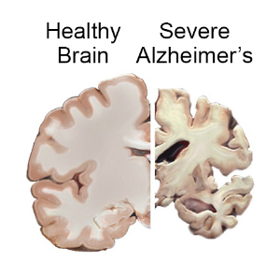
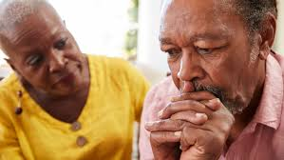
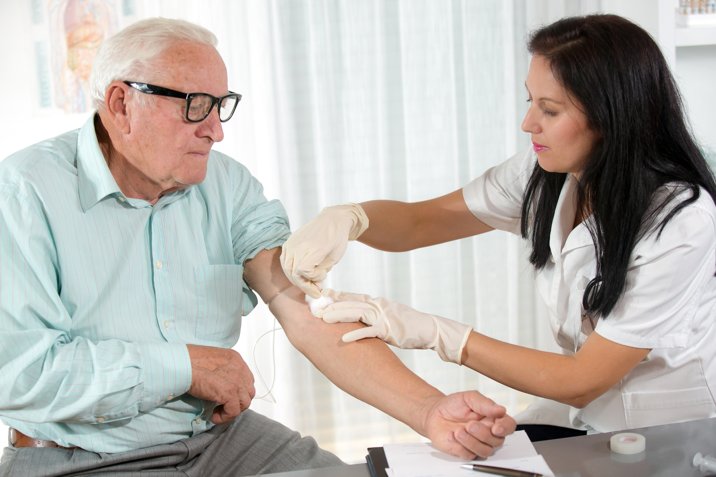
Blood Biomarkers - 5 key unanswered questions
Lack of accurate diagnoses
Should we use blood biomarkers in the real world?
Rapidly emerging biomarkers
How valid are biomarker(s) for diagnosis and prognosis?
Little data in under-represented populations
Do thresholds vary by ethnicity, age, comorbidity, delivery method?
Utility & communication
How best to share results?
Delivery challenges
How to use BBMs in better services?
Notes:
First I want to thank the panel for inviting us and for the reviewers for their very helpful comments, which we, as 3 co-leads, will aim to address in this presentation, together with an overview of what our proposal would deliver.
I’m going to start with summarising what we see as the 5 main unanswered questions concerning BBMs.
The first issue is that many people still do not get a dementia diagnosis and if they do, it often lacks accuracy, so a key question is whether BBMs will help and add value?
There are a lot of data around emerging BBMs, but the validity of these, whether individually or as part of a panel, and in particular validity around prognosis are lacking
This is compounded by the lack of data in certain under represented groups, especially concerning the impact of ethnicity, increasing age and comorbidities, plus also the optimal delivery method to be used
We need to understand the RW clinical utility of BBMs and how information from them should be imparted and when
And finally there are obviously significant delivery challenges and questions around how we build BBMs to be scalable and sustainable in the NHS

Slide 19
REAl world Dementia OUTcomes (READ-OUT) aims
Validation in real-world populations
Health economic analyses
Disclosure impact
Evidence base for:
Diagnosis and prognosis
AD and non-AD
Aligned DPUK data
Optimum thresholds:
Ethnicity
Age
Comorbidities
PPIE input
Easy to interpret results for patient & doctor
PPIE-informed disclosure process
Test-retest
Processing delay
At-clinic vs postal
Optimal, scalable delivery
Notes:
The READ-OUT study will deliver outcomes to address each of these questions and establish a pathway for BBM use
We will use our preexisting network to deliver validation in RWPs, and provide vital evidence for the HE analysis of their use and disclosure
This will establish an evidence base for diagnostic and prognostic BBMs, for both Alzheimers Disease and other dementias, and we will maximise the validation of these by aligning our data with existing DPUK study data and processes within other ongoing cohorts
We will also provide thresholds for BBMs based on ethnicity, age and comorbidities, developed with public and patient input
To address utility and communication, we will then provide a framework for standard results interpretation and disclosure for future role out
And to address the big question of delivery, we will test varied ways of delivering BBMs and work with commissioners and industry partners to create a future-proof pathway for their use

Slide 20
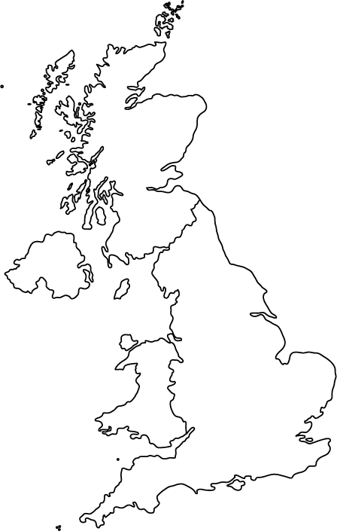
Integrated Care Boards/Commissioners
Bristol, North Somerset and South Gloucestershire ICS
Buckinghamshire, Oxfordshire and Berkshire West ICB
Cambridgeshire & Peterborough ICS
Coventry and Warwickshire ICS
Gloucestershire ICS
Greater Manchester ICS
Humber and North Yorkshire ICS
Lincolnshire ICB
Suffolk and North East Essex ICB
North Central London ICS
Shropshire, Telford and Wrekin ICS
Staffordshire and Stoke-on-Trent ICS
Surrey Heartlands Health and Care Partnership
Sussex ICS
READ-OUT network reach
Additional Partners
Akrivia Health
Alzheimer’s Scotland
CFDX
Cytox Ltd.
Davos Alzheimer’s Collaborative System Preparedness Program (SUI)
Dementia Translational Research Collaboration
Diadem
Diverse Cymru
Eisai Inc.
Eli Lilly and Company
Global Alzheimer's Platform (USA)
Roche Diagnostics
Scottish Dementia Research Consortium
St. George’s University of London
Sysmex Corporation
Teakisi
FAST Sites - already collecting BBMs
Aneurin Bevan University Health Board
Avon and Wiltshire Mental Health Partnership NHS Trust
Berkshire Healthcare NHS Foundation Trust
Bradford District Care NHS Foundation Trust
Cambridgeshire & Peterborough NHS Foundation Trust
Devon Partnership NHS Trust
Herefordshire and Worcestershire Health and Care NHS Trust
Kent and Medway NHS and Social Care Partnership Trust
Oxford University Hospitals NHS Foundation Trust
Oxford Health NHS Foundation Trust
Sheffield Memory Clinic
Solent NHS Trust
Somerset NHS Foundation Trust
South London & Maudsley NHS Trust BHC
Surrey & Borders Partnership NHS Foundation Trust
Sussex Partnership NHS Foundation Trust
: TDF Sites
: FAST Sites
: ICB Sites
: Additional Partners
Notes:
This slide demonstrates the reach of our network of sites, which includes 14 Integrated Care Boards, as well as partner networks in the devolved nations and outside of the UK, to allow maximal sharing of knowledge and expertise

Slide 21
READ-OUT: Partnering with People With Lived Experience
In design:
Specialist group for PPIE (Patient and Public Involvement and Engagement), additional representatives from 10 strategically diverse PPIE groups allowing high level input
“A blood biomarker test for dementia, and ideally to identify the sub-type of dementia, would be a great diagnostic breakthrough…”
In operation:
Co-production and impact assessment involving under-served communities
Includes defining utility, trade off false positive/negative, mode of delivery
Mixed methods analysis to optimise communicating complex results
Notes:
This proposal has been built and will be further developed in partnership with people with lived experience, to reflect ARUK’s and AS research strategies
We already have a specialist PPIE group in place, which will be augmented by additional representatives from 10 strategically selected, diverse groups
And here we have a quote from a member of our group, highlighting the massive opportunity BBMs provide
We will use our ongoing PPIE work to co-produce a robust study and to achieve optimal ways of communicating complex results, with PPIE representation at all levels
This will include work around defining clinical utility, how we balance the trade off between false positives and negatives and what is the optimal mode of delivery of BBMs

Slide 22
READ-OUT: Network & Recruitment
Accuracy/sensitivity in under-represented - min 30% recruitment based on ethnicity & comorbidity, 10% “not yet engaged”
Prioritise sites based on population
Use recruitment procedures effective in GAP Inclusive Research Initiative
Involve ‘Community Connectors’
Engage community partners - government/faith/organisations/media
Utilise local services and research buses
Personalise communication and brain health
Notes:
We are aware we need a multi-faceted approach in order for this study to address the inequalities in dementia risk and biomarker data
We need to know if BBMs are accurate and sensitive in certain groups, so we will have a target of at least 20% recruitment from black and Asian ethnic groups and 10% with comorbidities, plus another 10% that are not engaged in memory clinics
We will do this by prioritising our sites based on data from clinical and research databases, and via census data for the non-engaged, building on ongoing work at sites and ICBs, and supported by a diverse advisory panel
We know the most proven way of engaging ethnically under represented groups is via community engagement and we will prioritise strategies successfully implemented by our partner, the Global Alzheimer’s Platform Inclusive Research Initiative Program, these being
a) ‘Community Connectors’ to coordinate efforts at sites
b) Engaging with multiple community partners
c) Working with representative local services, ensuring cultural competence and including the use research buses to allow maximal access
d) Personalised communication & educational programmes around brain health to help foster trust
We will record and review data around recruitment with our advisory panel, thereby creating a dynamic approach
I will now pass over to James Rowe to discuss our biomarker strategy

Slide 23
READ-OUT: Which is the best biomarker(s)?
Easy-to-use in clinic for big questions
Is there Alzheimer’s disease?
Is there neurodegeneration or dementia pathology?
Is the likely prognosis rapid or slow?
Accurate, high positive and negative predictive value
Single biomarker? - pTau217 blood sugar in diabetes
Small set of biomarkers? - pTau217, NfL, GFAP, AB current CSF markers, or lipids profile
Simple biomarkers plus clinical? - pTau217+age+comordidity cf. “ABCD” stroke risk
Multivariate profiling? - BBM panel and demographics. AI-diagnostic algorithm
Notes:
So the first phase of readout will address the question of what are the best blood based biomarkers to answer those big questions we have day in, day out in clinic, do I have Alzheimer's disease? Do I have some other neurodegenerative or dementia pathology? And if I do, what is the outlook for me? Will my illness progress rapidly or slowly? The blood biomarkers might achieve this individually as a single chemical. For example, Ptau 1217 will be a strong candidate. Similar to, for example, the use of a single blood sugar measurements in diabetes.
But it may need a set of biomarkers used together, which is in fact the way that spinal fluid or lumbar puncture tests work.
These sets of biomarkers might be enhanced by integrating with clinical or demographic data in a way that other branches of medicine use such as in stroke risk profiling. And more sophisticated models with AI based techniques could also give maximum accuracy in performance. But to determine this we're going to run an observational study highlighted in the next slide.

Slide 24
READ-OUT: Observational study
Main study:
Diagnosis and prognosis
Sub- study 1:
Test-retest reliability
Sub- study 2:
Processing delays
Tier 1
Tier 2
Tier 3
Sub- study 3:
Blood spot assay
N=3165;
Diverse subgroups
Delivery mode and retest
Best BBM performance for patients and healthcare
Singular
(standalone)
Combined
(multivariate)
Integrated
(clinical, age, ethnicity)
4 x Validation
Blood Biomarker Performance
Clinical Trial selection
Accuracy
PPV, NPV
Sensitive
Specific
PPIE input
ICB input
PPIE - Patient and Public Involvement and Engagement, ICB - Integrated Care Board, PPV - positive predictive value, NPV- negative predictive value
Notes:
With about 3000 participants taking blood in the main study and we'll focus our analysis on what we call tier 1 and tier 2 blood biomarkers. Tier 1 BBMs are those that have already reached the Alzheimer's Association level 3 evidence and many of which already in the clinical use around the world or even direct to consumer. Tier 2 Bloods, have a substantial evidence base. By that we mean regular use in research studies and are of high interest but might fall short on level 3 evidence so far.
But for all of these different assays, we're going to ask whether they should be used individually as a single biochemical test, in combination as a set of biomarkers, or in integration with clinical and demographic data. We will ask whether they perform adequately - are they accurate, do they have strong positive predictive value to rule in an illness or negative predictive value to rule it out? Are they sensitive and specific? And the thresholds for this are really going to be informed by Commissioners and patient and public input. We also have some sub studies looking at the robustness and reliability of the assays, and ways to double check the validity of the biomarker performance.
But ultimately, by the end of year three, we will know which is the best biomarker or biomarkers to take forward to the randomised clinical control trial that Ivan Koychev will describe on the next slide.

Slide 25
READ-OUT:
Randomised Controlled Trial
Cluster RCT
(n = 440 /arm)
Hypothesis 1: Biomarkers improve Quality of Life
Hypothesis 2: Biomarkers reduce healthcare costs
Inclusion = real-world clinics, diagnosis, severity, age
1° endpoint = EQ-5D-5L
As NICE recommended, for health status & commissioning
Disclosure 2 weeks
No disclosure
1◦ outcome = Participant rated quality of life
2◦/3◦ outcomes
Carer quality of life
Participant and carer acceptability
Symptoms: anxiety, cognition, function
Use of healthcare + resources
Notes:
The trial component of the proposal leverages the knowledge we obtained from the observational study to test 2 hypothesis that in our view are critical to establishing the clinical utilities of blood biomarkers. But as well, whether they improve the quality of life of patients, and whether they reduce the healthcare costs of dementia. We will do this by randomising 880 individuals into two groups, one where disclosure of blood results is done two weeks after they're taken and another where no disclosure is made.
Population are up in these of secondary care memory clinical services with a dementia related diagnosis. The primary outcome is participant related quality of life as this is the key measure that NICE uses to establish cost effectiveness. We’re also interested in the number of secondary and tertiary outcome measures such as patient and carer quality of life, patient and carer acceptability, patient symptoms such as health, anxiety, cognition and activities of daily living. Importantly for the health economic aspect of readout, we will also investigate use of healthcare and other resources.

Slide 26
READ-OUT: Health Economic Framework
Coherent framework to inform decisions under uncertainty
Comparing blood biomarkers with current care:
What impact on quality of life?
QALYs and other outcomes
What resources are people likely to use?
Primary data collection
ECONOMIC MODEL
Lifetime costs healthcare + societal
What are the costs of services?
READ-OUT findings
Existing knowledge
5-year NHS budget impact
ICBs
QALY - Quality Adjusted Life Year, ICB - Integrated Care Board
Notes:
The key question for the HE workstream is what are the costs of incorporating BBMs into clinical care – do they give value and are they affordable?
We will use data from the two arms of the study, plus from published literature, to produce an economic evaluation of quality adjusted life years, incremental costs and cost-effectiveness, in other words, value. We will then follow NICE guidance on budget impact analysis to establish NHS costs relative to current care and affordability, based on
- the size of the population and expected uptake of BBMs
current and future clinical pathways and their costs as agreed with our partnering ICBs
The model will include health and social care resource use, but also wider lifetime, societal costs, such as informal care costs and carer productivity losses collated via questionnaires - data which are especially lacking, particularly in under represented groups. We will access expert opinions on the conceptual model , including from the ICBs

Slide 27
READ-OUT will provide:
Efficient network = inclusive, diverse, rapid - using established TDF sites
Work with partners = strong PPIE, 14 partnering integrated care boards (ICBs) and industry support to roll out assays UK-wide
Maximum information = via aligning validation data, sub-studies and trials in AD and non-AD dementias
Collaboration with ADAPT = to provide complimentary outputs (ptau 217)
→ for fast & effective benefit for patients & carers
Notes:
So to summarise we will leverage a diverse, existing UK wide network, for rapid set up and recruitment
We bring a wide set of stakeholders, including an existing public and patient involvement and engagement group, UK wide commissioner representation and industry buy in
We are building on ongoing work collecting BBMs and have developed an accessible protocol for maximum representative recruitment
And we feel our study will provide maximum information by using our aligned work for validation, and because of our focus on utility in real world settings via our sub-studies
Overall this means we can provide a fast and effective way of developing an optimal pathway for patient benefit

Slide 28
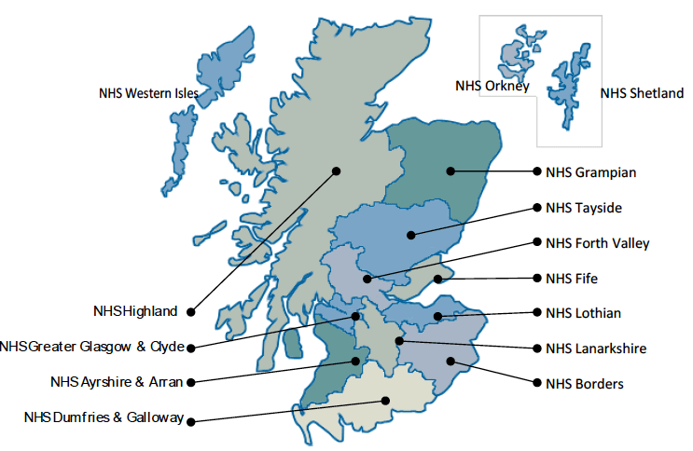
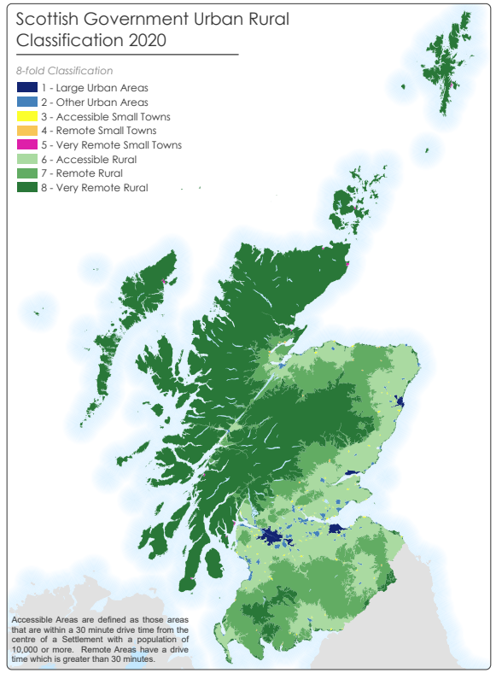
Scottish Health Boards
Population and Demographics
Area | % datazones in 15% most deprived
SCOTLAND | 15.4
MAINLAND HEALTH BOARDS
NHS Greater Glasgow and Clyde | 29.8
NHS Lothian | 7.5
NHS Tayside | 14.0
NHS Grampian | 2.8
NHS Lanarkshire | 19.9
NHS Fife | 16.0
NHS Ayrshire and Arran | 21.7
NHS Highland | 7.6
NHS Forth Valley | 11.5
NHS Dumfries and Galloway | 7.0
NHS Borders | 4.9
ISLAND HEALTH BOARDS
NHS Western Isles | 0.0
NHS Shetland | 0.0
NHS Orkney | 0.0

Slide 29
DPUK TDF - the next 12 months
Start READ-OUT!
Expand dementia infrastructure in diverse settings
Use biomarkers & cohorts for prescreening registry in non-traditional settings
Mentorship/support to increase late phase trials infrastructure
Support UK service delivery
NHS linkage & data sharing, beyond DPUK
DPUK3

Slide 30
Summary
Dementia trials and management are changing despite multiple hurdles
Blood biomarkers = opportunity
More treatments and personalised risk management on the way
We need everyone to get involved!

Slide 31
Thank you!
Questions?

